Slide 1
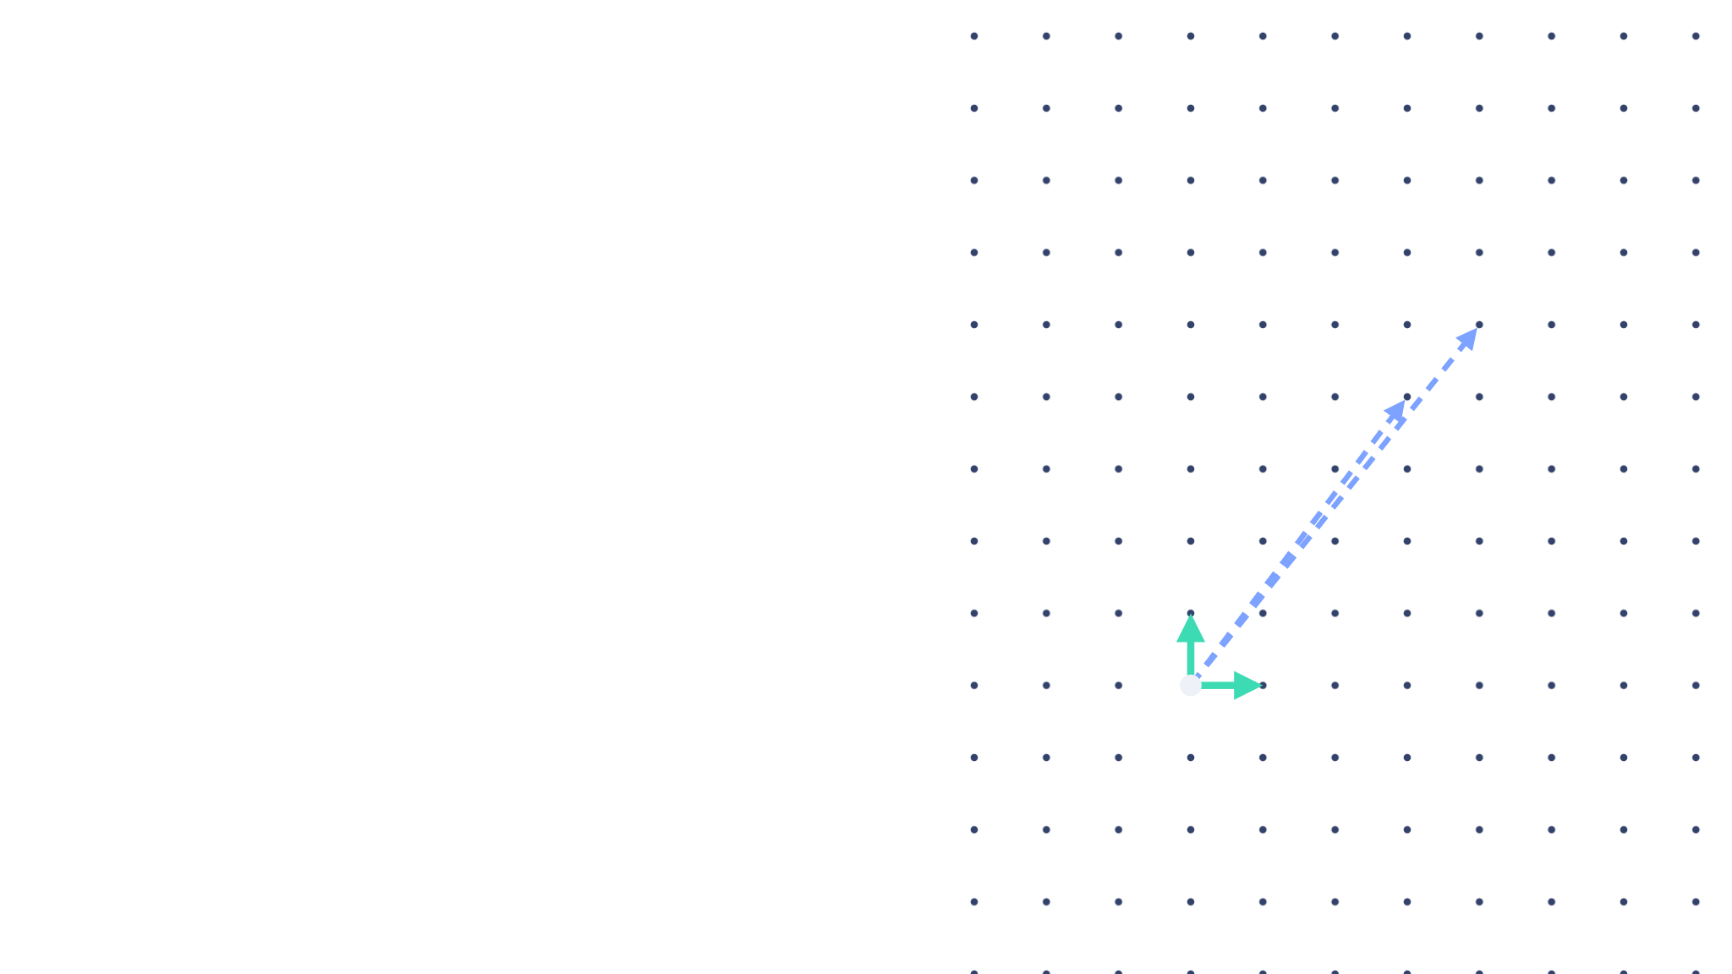
PPSEB · XU ET AL., 2022
PPSEB Under Reproduction: Concrete Parameter, Protocol, and Deployment Analysis
long = public
Explained PPSEB from first principles
Reproduced its construction and parameters
Identifed cryptographic and protocol weaknesses
Proposed a deployable, forward-secure EHR search architecture
short = secret
Princy Patel- 2026909002
Ishit Agarwal-2026909005
Shivam Patel-2025

Slide 2



THE PROBLEM
The cloud stores everything. It must learn nothing.
CLOUD · CIPHERTEXT ONLY
WHAT THE CLOUD LEARNS
Patient
encrypt
Record contents
nothing
CM₁
CM₂
CM₃
The keyword
nothing
test on ciphertext
Which record matched
Doctor
ask
“diabetes” ?
a pointer

Slide 3
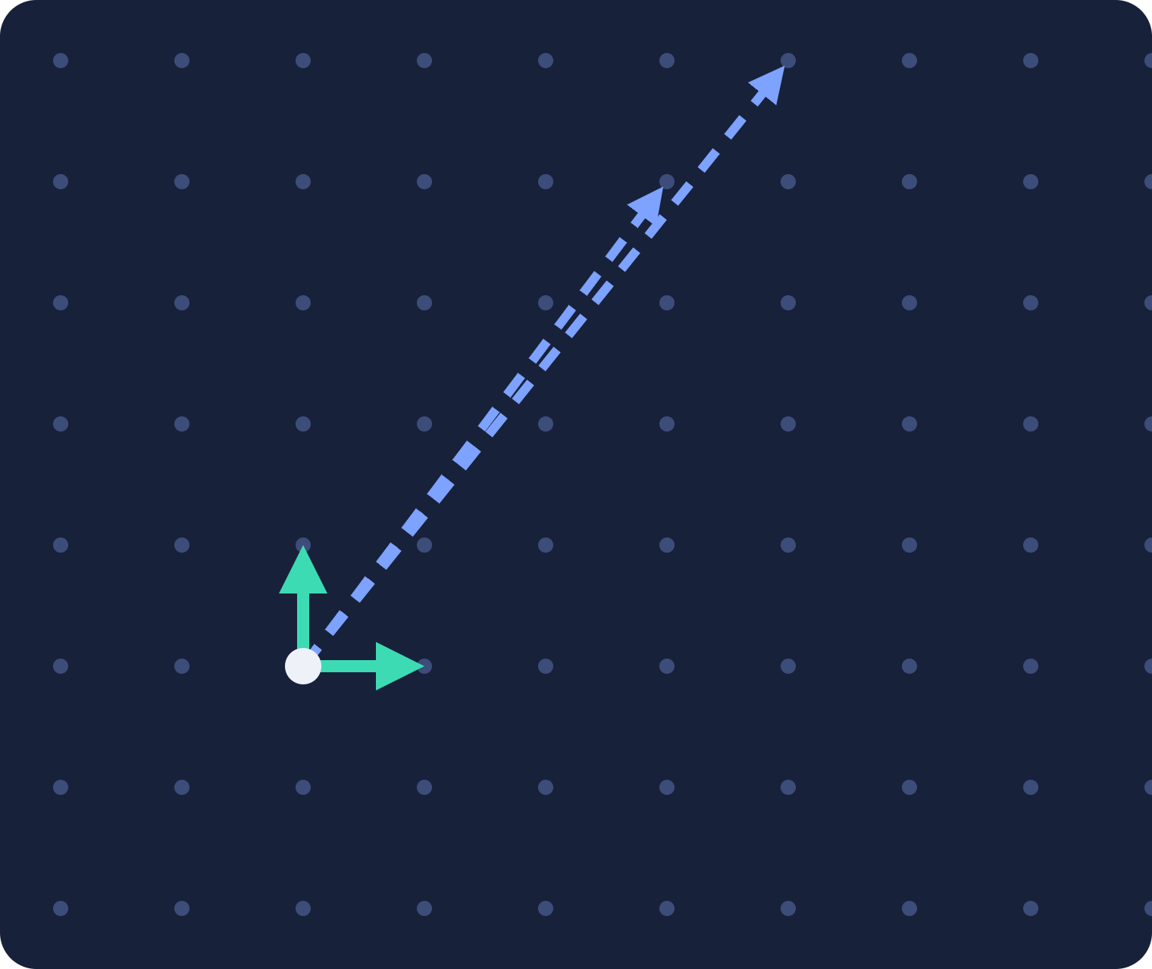


FOUNDATION 1 · THE TRAPDOOR PREIMAGE PROBLEM
Given A, find a short basis of its solution space.
solution space Λ⊥q(A)
A = public key matrix
long basis
n × m, entries mod q
Tᴀ = short basis = trapdoor
m × m, the secret key
Tᴀ
easy
A
hard — even for quantum
short basis Tᴀ
Λ⊥q(A) = { x ∈ ℤᵐ : A·x ≡ 0 mod q }
preimage: short x with A·x = u — needs Tᴀ

Slide 4
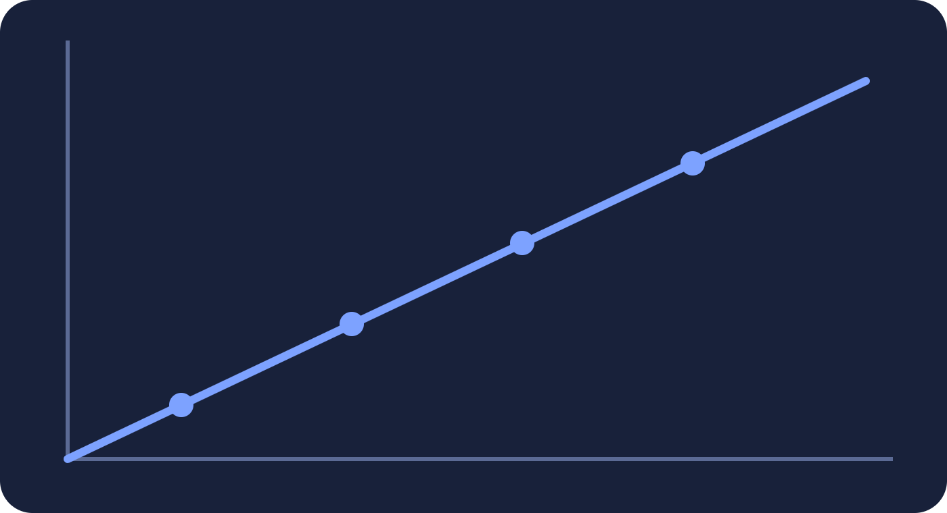
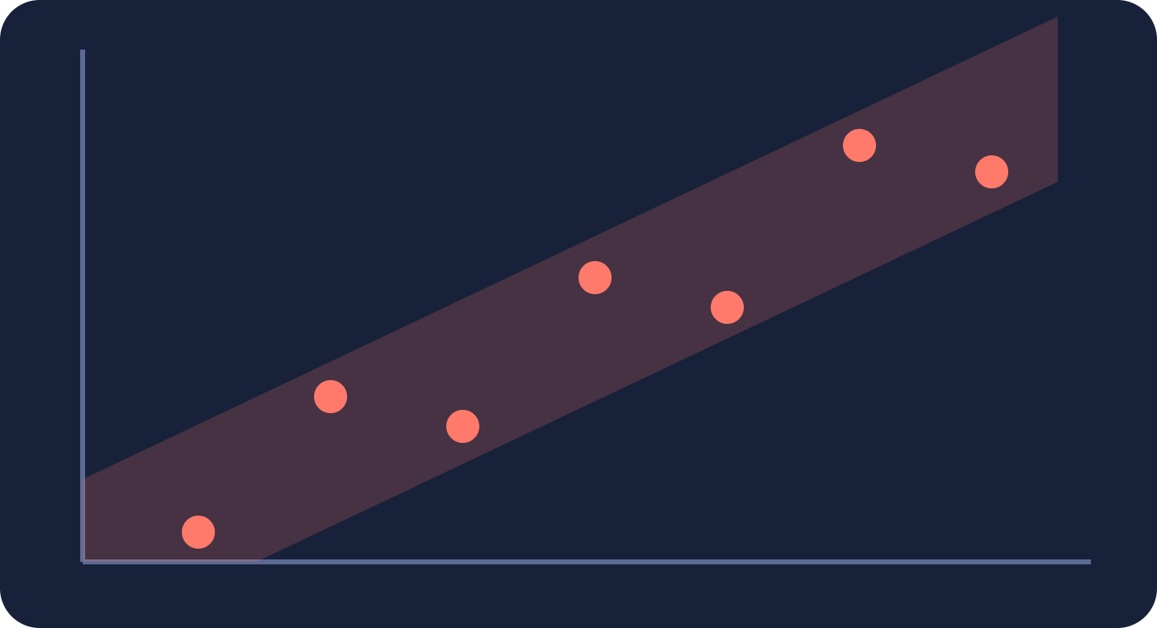

FOUNDATION 2 · LEARNING WITH ERRORS
Add noise. Linear algebra becomes a wall.
b = Aᵀs
b = Aᵀs + e
+ noise e
solvable in seconds
hard — even for a quantum computer
too little → breakable
noise e — just right
too much → decryption fails

Slide 5
NOTATION
Every symbol, with its size.
Symbol | Size | What it is
q, n, m | q prime, m ≥ 2n log q | modulus and lattice dimensions
l | integer | security level of the test
μ | n-vector mod q | public random vector, the target of every trapdoor
pk, sk | n×m mod q, m×m short | doctor's key pair (TrapGen), evolves each period j
H₁(pk‖j) | m×m matrix | hash that drives key evolution
β = H₂(w‖j) | m×m matrix | hash of keyword w and period j
B | n×l mod q | fresh random matrix, one per keyword ciphertext
e₁, e₂ | 1×l, m×l | small Gaussian noise (noi, noiv in the paper)
y | l bits | match marker, all ones
Trap | short m-vector | search token: (pk·β⁻¹)·Trap = μ

Slide 6



THE TOOLKIT
Three tools, with their inputs.
TrapGen(q, n)
SamplePre(A,Tᴀ,s,v)
NewBasisDel(A,R,Tᴀ,s)
A : n×m matrix
A : n×m matrix
q : prime modulus
Tᴀ : short basis, m×m
R : invertible, m×m
n : lattice dimension
s : Gaussian width
Tᴀ : short basis of A
with m ≥ 2n log q
v : target n-vector
s : Gaussian width
A (n×m) + Tᴀ (m×m)
short w : A·w = v
Tʙ for B = A·R⁻¹
a public matrix plus its short basis
solves the preimage, an m-vector w
moves the trapdoor to a new matrix

Slide 7



NEWBASISDEL IN PPSEB
One tool, two jobs.
NewBasisDel(A, R, Tᴀ, s) → Tʙ, B = A·R⁻¹
a · Keyword-specific basis
b · Key evolution
A = pkⱼ (doctor, period j)
A = pkᵢ (earlier period i)
R = βⱼ = H₂(w‖j)
R = H₁(pk‖j) ··· H₁(pk‖i+1)
Tᴀ = skⱼ, s = δⱼ
Tᴀ = skᵢ, s = δⱼ
sk(w‖j) : basis for pkⱼ·βⱼ⁻¹
skⱼ : basis for pkⱼ = pkᵢ·R⁻¹
then SamplePre uses it to make Trap
the doctor's secret key for period j

Slide 8





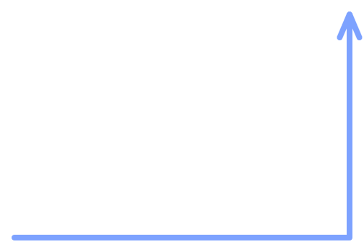
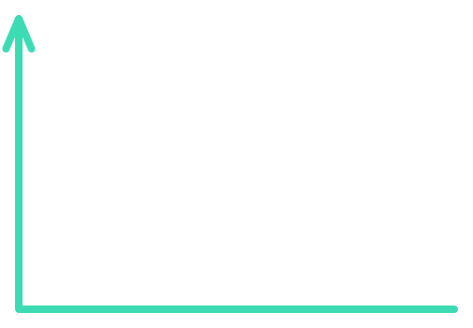


THE ARCHITECTURE
Blockchain replaces the trusted searcher.
Cloud
CM₁
CM₂
CM₃
off-chain storage
4 · sequence no.
1 · encrypted record
BLOCKCHAIN · KEYWORD INDEX + TEST
5 · encrypted record
CT₁
CT₂
CT₃
Test( )
2 · keyword ciphertext
3 · trapdoor
Patient
Doctor
data owner
data user

Slide 9


KEYS EVOLVE WITH TIME
Re-grown each period: forward easy, back hard.
period 0
period 1
period 2
today
sk₀
NewBasisDel · R₁
sk₁
NewBasisDel · R₂
sk₂
NewBasisDel · R₃
sk₃
✕ no way back
✕ no way back
✕ no way back
Periods 0–2 stay locked
forward security
sk₃ stolen

Slide 10

ENCRYPT THE KEYWORD
Two halves, one shared secret B.
mask
noise
match marker
CT₁ =
μᵀB
+
e₁
+
y⌊q/2⌋
1 × l
same random B
B : n×l, fresh random
CT₂ =
(pk·β⁻¹)ᵀB
+
e₂
μ : n-vector, public
β : m×m, from keyword
pk : n×m, doctor, period j
m × l
e₁ : 1×l, e₂ : m×l
β = H₂(“diabetes”‖j)
y : l marker bits

Slide 11
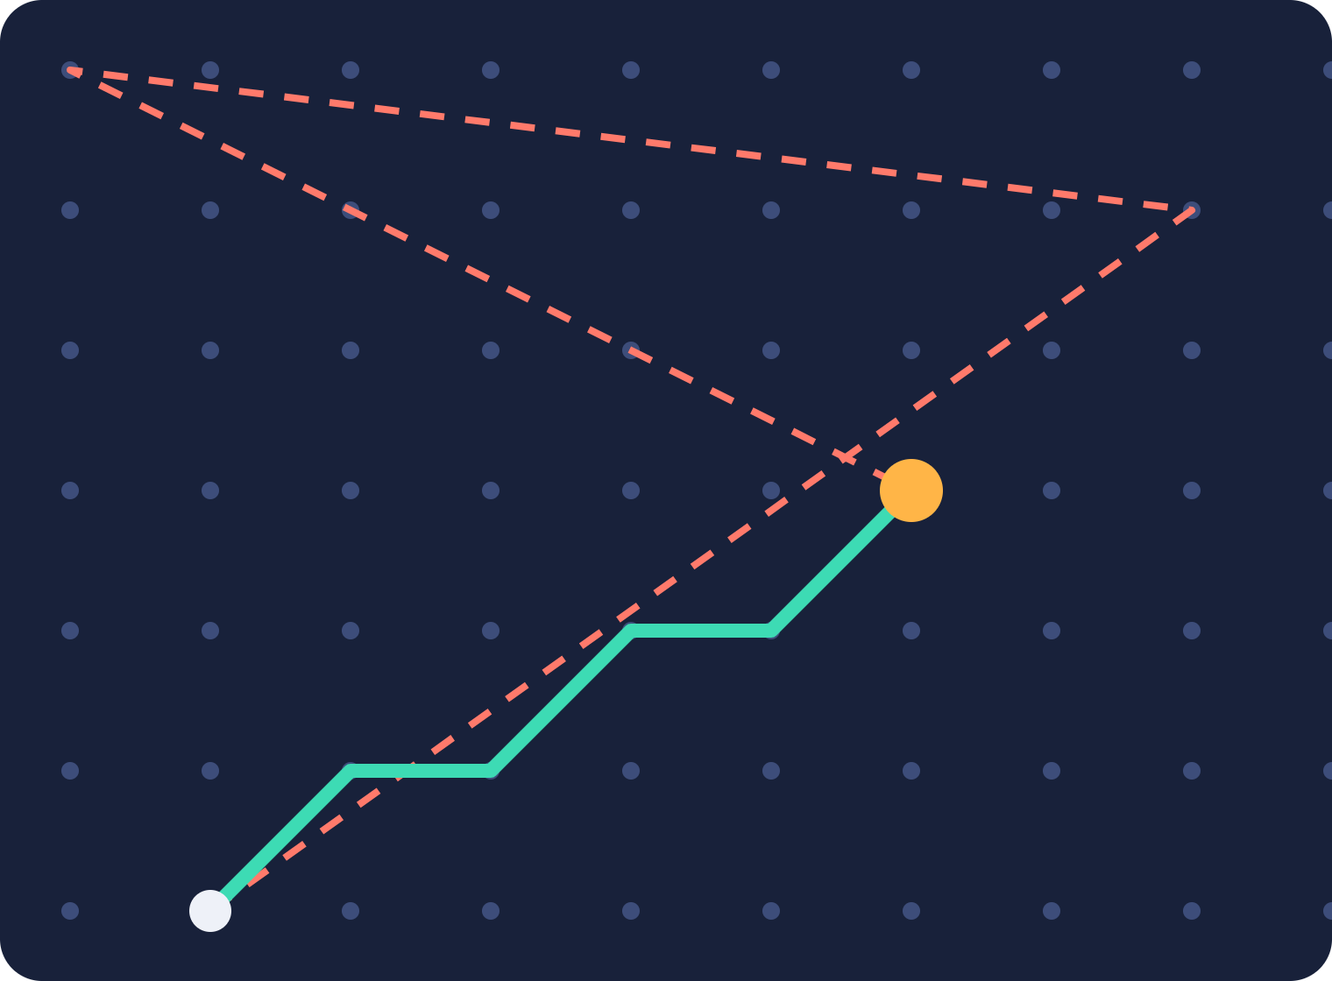

THE SEARCH TOKEN
A short walk to μ. Only the doctor can find it.
w = “diabetes”, period j
β = H₂(w‖j) (m×m)
NewBasisDel(pkⱼ, β, skⱼ, δⱼ)
μ
sk(w‖j) : short basis for pkⱼ·β⁻¹
SamplePre(pkⱼ·β⁻¹, sk(w‖j), μ, σⱼ) → Trap
━ short steps = Trap
┅ long steps = useless
(pkⱼ·β⁻¹)·Trap = μ, Trap: short m-vector

Slide 12
THE MATCH TEST · STEP 1 OF 4
Subtract one ciphertext from the other.
Δ =
CT₁
−
Trapᵀ
·
CT₂
on chain · from patient
from doctor
on chain · from patient
Three public inputs. No secret key.

Slide 13

THE MATCH TEST · STEP 2 OF 4
Open both ciphertexts.
CT₁
CT₂
Δ =
μᵀB
+
e₁
+
y⌊q/2⌋
−
Trapᵀ
·(
(pk·β⁻¹)ᵀB
+
e₂
)
(pk·β⁻¹)·Trap = μ
true only when the keywords match

Slide 14
THE MATCH TEST · STEP 3 OF 4
The two B-terms meet and cancel.
Δ =
μᵀB
−
μᵀB
+
y⌊q/2⌋
+
e₁ − Trapᵀe₂
equal → cancel
survives
tiny
Wrong keyword → the B-terms differ → nothing cancels.

Slide 15
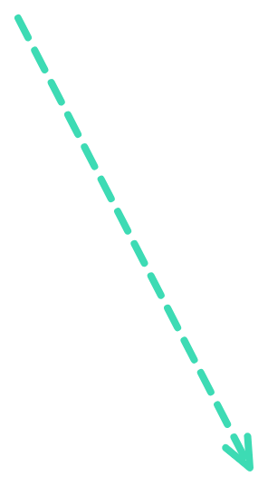
THE MATCH TEST · STEP 4 OF 4
Read the marker.
Δ ≈
y⌊q/2⌋
+ small noise
within q/4 of the centre → MATCH
no match
no match
0
⌊q/2⌋
q

Slide 16





VERIFICATION ON CHAIN
Every node repeats the same public test.
Node 1
Test ✓
PUBLIC INPUTS
Node 2
Test ✓
CT₁, CT₂
Consensus
N₀ = 3
Trap
Node 3
Test ✓
sent to the cloud server
Node 4
Test ✓
No secret key in the test, so no single party can lie about the result.

Slide 17

THE PROTOCOL IN DETAIL · ONE KEYWORD W
Who sends what, and where it lives.
Patient
Cloud server
Doctor
encrypts the chunks
1 · chunks (i, CMᵢ)
stores the chunks
5 · CM at N₀
receives and decrypts
CMᵢ = Enc(pkⱼ, Mᵢ)
(1, CM₁) … (n, CMₙ)
M = Dec(skⱼ, CM)
looks up N₀, never decrypts
4 · N₀ or False
Blockchain
encrypts keyword w
2 · (N₀, CT)
stores, after consensus
3 · Trap
builds the trapdoor
CT = PEKS(w, j)
(N₀, CT)
β = H₂(w‖j)
signs the transaction
runs Verification
Trap = SamplePre

Slide 18
SUMMARY · ONE SEARCH, END TO END
“Find the diabetes record.”
Patient
Cloud
Chain
Doctor
1 · encrypted chunks CM
2 · keyword ciphertext (N₀, CT)
3 · Trap(“diabetes”)
4 · match → N₀ = 3
5 · returns CM₃
Keyword and plaintext never leave the doctor.
6 · decrypt → record

Slide 19



WHAT IT PROMISES
Three pillars.
Post-quantum
Forward secure
Efficient
reduces to LWE
the past survives a theft
small, fast, practical
Next: we put all three on the bench.

Slide 20
PART 2 · ATTACK ANALYSIS
Three pillars. We tested all three.
Post-quantum · forward-secure · efficient: what survives contact with an attacker.
Almost every flaw traces to something the paper left unspecified, and the public blockchain is what makes the attacks possible.

Slide 21
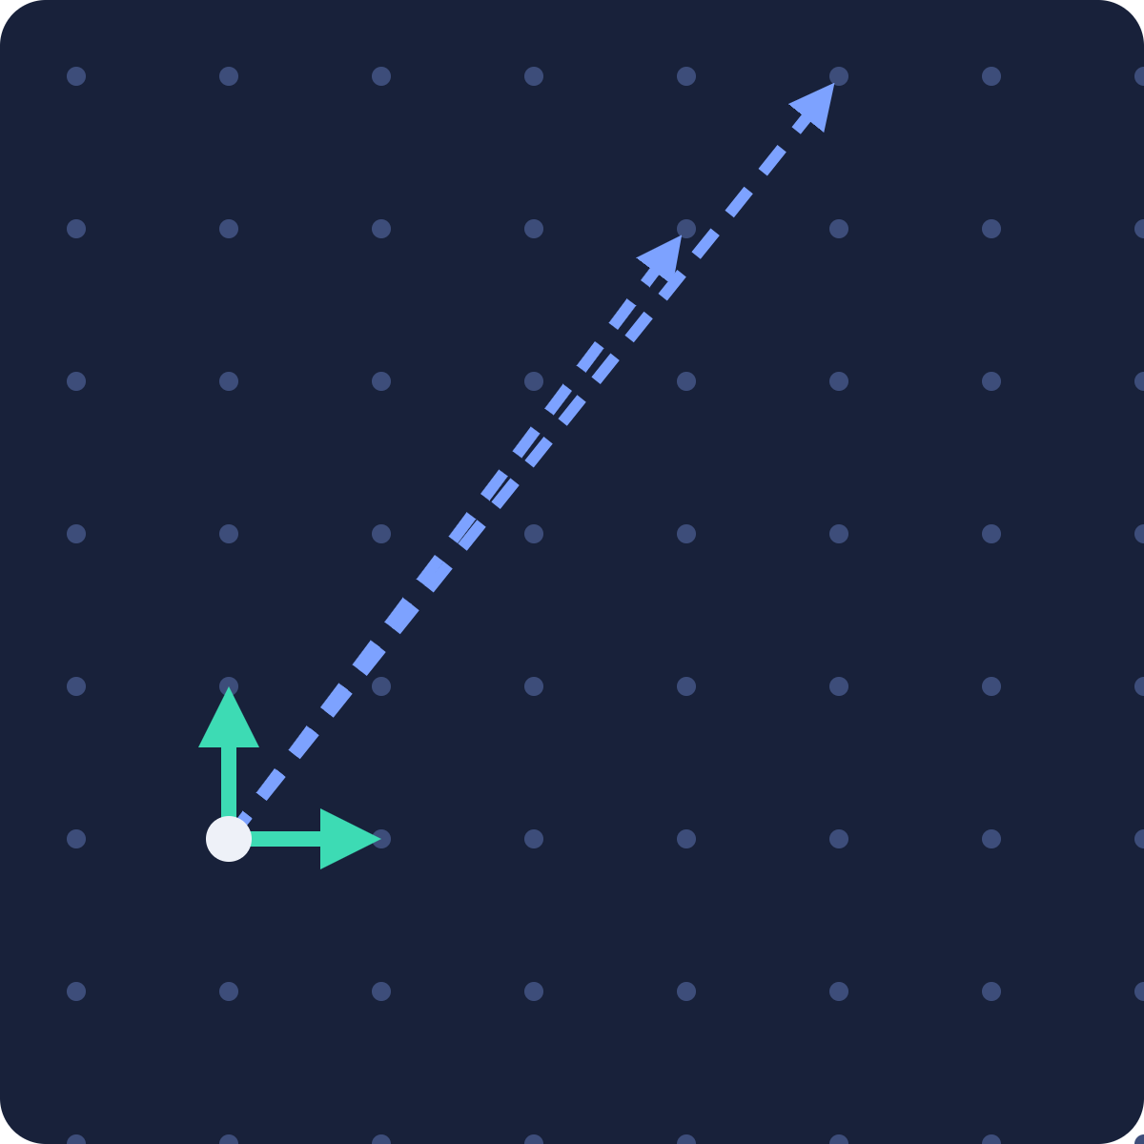
THE METHOD
How we attacked: lattice reduction.
BLOCK SIZE Β SETS THE COST
public
β = 2
LLL: cheapest, weakest
β = 20–60
stronger, cost 2^(0.292·β)
β ≈ 400+
needed for 128-bit security
Our attacks ran at β = 2. The weakest tool was enough.
secret
LLL / BKZ: long → short
The secret key is a short basis. Breaking the scheme means turning the public long basis into a short one.

Slide 22
WHAT WE ARE ATTACKING
What must stay small: the real error term.
Δ = CT₁ − Trapᵀ·CT₂
= (μᵀB + noiⱼ + y⌊q/2⌋) − Trapᵀ((pk·β⁻¹)ᵀB + noivⱼ)
1 · plug in both ciphertext halves
(pk·β⁻¹)·Trap = μ ⟹ Trapᵀ(pk·β⁻¹)ᵀB = μᵀB
Δ =
μᵀB
+ noiⱼ + y⌊q/2⌋ −
μᵀB
− Trapᵀ·noivⱼ
2 · the two μᵀB terms are identical: they cancel
Δ =
y⌊q/2⌋
+
noiⱼ − Trapᵀ·noivⱼ
3 · the marker survives; everything else is the error
THE ERROR
| noiⱼ − Trapᵀ·noivⱼ | < q/4 ⟹ VERIFIES
The error carries Trapᵀ·noivⱼ, so it grows with ‖Trap‖. The entire attack reduces to: make ‖Trap‖ short.

Slide 23

THE ATTACKER'S LEVER
Where ‖Trap‖ comes from, and how we shrink it.
sk_r · period basis
‖T̃_r‖
We don't have sk_r.
sk_w = NewBasisDel(pk, β, sk_r)
We take a long basis from public data and shorten it until its Trap has error under q/4.
sk_w · word basis
≈ ‖T̃_r‖·‖β‖·poly grows
Trap = SamplePre(pk·β⁻¹, sk_w, μ, σ)
long public basis
↓ LLL / BKZ
Trap · search token
‖Trap‖ ≲ σ·√m
short basis
feeds the error Trapᵀ·noivⱼ
↓ SamplePre
short Trap → VERIFIES
error < q/4 ?
VERIFIES ⟺ ‖Trap‖ small
At the paper's parameters, β = 2 (plain LLL) is already enough.
Each step can only make the trapdoor longer. To verify, the chain must start from a short basis.

Slide 24


KEY EVOLUTION · PERIOD J−1 → J
Key evolution: what feeds what.
PUBLIC TRACK · ANYONE CAN COMPUTE
pkⱼ₋₁
H₁ hash
Rⱼ
multiply
pkⱼ = pkⱼ₋₁ · Rⱼ⁻¹
low-norm, invertible
NewBasisDel consumes both public values…
SECRET TRACK
skⱼ₋₁
NewBasisDel(pkⱼ₋₁, Rⱼ, ·)
skⱼ
…and this
Forward (public): multiply by Rⱼ⁻¹. Cheap, anyone.
Secret basis: needs the old short basis.
Each period's lattice is a public transform of the last. Only the short basis is secret, which is what we attack next.
“Forward security relies on the hardness of recovering short bases; at small parameters this hardness fails.”

Slide 25

FINDING 1 · SPEC DEFECT
We identify a specification/reproducibility defect in Algorithm 2
Paper version
Corrected: valid key chain
A·T ≡ 0 in every period · bar height = ‖T̃‖
6: R = H1(pk_rj, j)
7: sk_rj = NewBasisDel(pk_rj, R, sk_rj, σ)
6.08
6.32
NameError: pk_rj not defined
5.19
4.92
UnboundLocalError: sk_rj
period 0 ✓
period 1 ✓
period 2 ✓
period 3 ✓
Fix justified three ways: the algorithm's own inputs, Lemma 5's signature, and Algorithm 4's analogous call.

Slide 26
FINDING 2 · PUBLIC-KEY-ONLY BREAK
The public key is the private key.
paper n=4 q=257
~20 bits · broke in 20 s
WHY IT BREAKS
paper n=8 q=257
~33 bits · broke in 224 s
n=4 q=1153
~25 bits · broke
expected shortest vector
2.79
n=8 q=1153
~38 bits · broke
n=4 q=4001
~21 bits · broke
honest secret basis
2.90
n=8 q=4001
~36 bits · broke
n=8 q=40961
~77 bits · not measured
The secret gives no advantage.
n=16 q=12289
~132 bits · not measured (compute budget)
estimated security bits · every break used BKZ β = 2
128-bit target
No secret, no stolen key. Scoped to the paper's demonstration parameters; asymptotic LWE is not broken.

Slide 27



FINDING 2 · WHAT THE BREAK YIELDS
From the public key: every patient's disease.
ATTACKER HOLDS ONLY
public key
Recovered | Truth | Match
diabetes | diabetes | ✓
hypertension | hypertension | ✓
HIV | HIV | ✓
… | … | ✓
dictionary
BKZ, β = 2
ciphertext DB
CONTROL
garbage key → recovers nothing
No cryptography is broken in the usual sense. The parameters are simply too small.

Slide 28



FINDING 3 · OFFLINE KEYWORD GUESSING
Guess the keyword. Test it yourself.
ATTACKER'S VIEW
flu
PEKS → Verify
no match
public key pk
one captured Trap
asthma
PEKS → Verify
no match
keyword dictionary
sk: locked, not needed
diabetes
PEKS → Verify
MATCH
The trapdoor is a public on-chain transaction. Anyone reads it; no device is compromised.
Encrypt and Verify are both public, so anyone can guess and test. Medical keyword spaces are small (thousands); the attack is linear in that size.

Slide 29
FINDING 4 · THE PROOF'S GUARANTEE, COMPUTED
Where the ≤7.4 bits actually come from.
Theorem 1: breaking the scheme ⟹ solving LWE, but the challenger succeeds only with probability 1/(2m). A loose reduction loses bits.
guaranteed_bits = LWE_bits − log₂(2m)
AT THE PAPER'S PARAMETERS: N = 4, Q = 257, M = 72
LWE_bits = 14.6
root-Hermite estimate of LWE hardness at (n = 4, q = 257)
log₂(2m) = log₂(144) = 7.2
m = 2·4·⌈log₂257⌉ = 72, so 2m = 144
guaranteed = 14.6 − 7.2
≤ 7.4 bits
2^7.4 ≈ 170 operations: breakable by hand. The theorem is not wrong; at these parameters it promises nothing.
LWE_bits is an upper-bound estimate, so 7.4 is itself an upper bound: the real guarantee is even lower.

Slide 30
FINDING 4 · THE REDUCTION LOSS
Even the paper's own theorem is empty here.
paper n=4 q=257
≤7.4
−7.2
≤7.4
n=8 q=257
≤6.4
−8.2
n=4 q=1153
≤7.1
−7.5
bits guaranteed at the paper's parameters
n=8 q=4001
≤6.0
−8.6
about 2⁷ work: by hand
n=16 q=12289
20.0
−9.8
guaranteed bits
lost in the reduction: log₂(2m)
Theorem 1's reduction loses log₂(2m) bits. It isn't wrong: at these parameters it promises nothing.

Slide 31
FINDING 5 · UNIVERSAL-CIPHERTEXT FORGERY
One ciphertext that matches every search.
CT₂ = 0
Δ = CT₁ − Trapᵀ·0
Verify ACCEPTS
CT₁ = ⌊q/2⌋·(1,…,1)
Δ = ⌊q/2⌋·(1,…,1)
for every trapdoor
planted entry
10 / 10 matched
random ciphertext (control)
0 matched
INTEGRITY / DoS
poisons results, reveals no keyword
A signature proves who sent it, not that it is well-formed. Anyone can register as a patient and sign a fake: open submission enables it.

Slide 32
FINDING 6 · ACCESS-PATTERN LEAKAGE
The public ledger leaks the diagnosis.
TIER 1 · CERTAIN
TIER 2 · STATISTICAL: LABELLING ACCURACY
7 / 7
75%
4×
19%
better than chance
record groups recovered, 100% pure
no prior knowledge, no crypto broken
frequency analysis
random chance
If the query distribution differs from the assumed prevalence, Tier 2 falls to about 20% (chance). Tier 1 grouping stays at 100%.

Slide 33


FINDING 7 · REPLAY
Catch a trapdoor, replay it, pull the record.
Doctor
Public ledger
Attacker
Replays
Cloud
searches
shows the Trap
captures it
same N₀ (#6)
returns CM
same N₀
no secret used
control: random Trap → 0
ATTACKER GETS
DOES NOT GET
the record ciphertext, and who accessed what
the plaintext, unless combined with the key break
Works at any parameters.

Slide 34
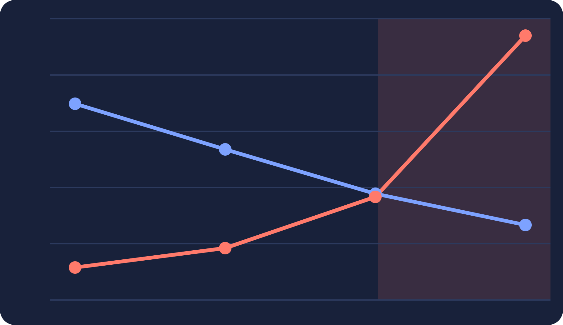
HONEST FINDING 8 · SCALING
Does it scale? The paper doesn't say.
REGIME A · FIXED NOISE WIDTH
REGIME B · PER-DIMENSION RESCALING
basis norm ‖T̃‖
824 s
20
usable threshold
245×
−16.80
10
cost per use, trapdoor-dominated
correctness cliff
3.4 s
0
n = 4
n = 8
n = 16
n = 32
n = 4
n = 16
A correctness cliff or a 245× cost wall, decided by a noise calibration the paper never specifies.

Slide 35

HONEST FINDING 9 · FORWARD SECURITY: VACUOUS, NOT BROKEN
Running the chain backward.
pkᵢ = pk_J · (Rᵢ₊₁·Rᵢ₊₂···R_J) = pk_J · R_prod
1 · every R is public
candidate = R_prod⁻¹ · sk_J
2 · invert it on the stolen basis
pkᵢ·candidate = pk_J·
R_prod·R_prod⁻¹
·sk_J = pk_J·sk_J = 0 ✓
a valid basis of the old lattice, but maybe long
BKZ(candidate)
short basis sk*ᵢ
Trap*
search frozen CTᵢ
3 · shorten it until it verifies
It produces a working old trapdoor. But the public key alone already does (β = 2), so the stolen key adds nothing.
Confirmed: the same attack with no stolen key gives the same recovery. Forward security is vacuous at these parameters.

Slide 36

THE MARGIN LAW · CORRELATION WITH RECOVERY
The basis norm doesn't predict the break.
decode margin
+0.87
1800
realized ‖Trap‖
+0.74
attempts; margin > 0 ⟺ accept held on every one
basis GS-norm
−0.19
basis
re-randomization
Gaussian width σ
‖Trap‖
margin
The basis sets the distribution; σ and the draw decide the actual Trap.
Two fresh random steps sit between the basis and the result: NewBasisDel and SamplePre. Widen σ and even a good basis produces a long Trap that fails.

Slide 37
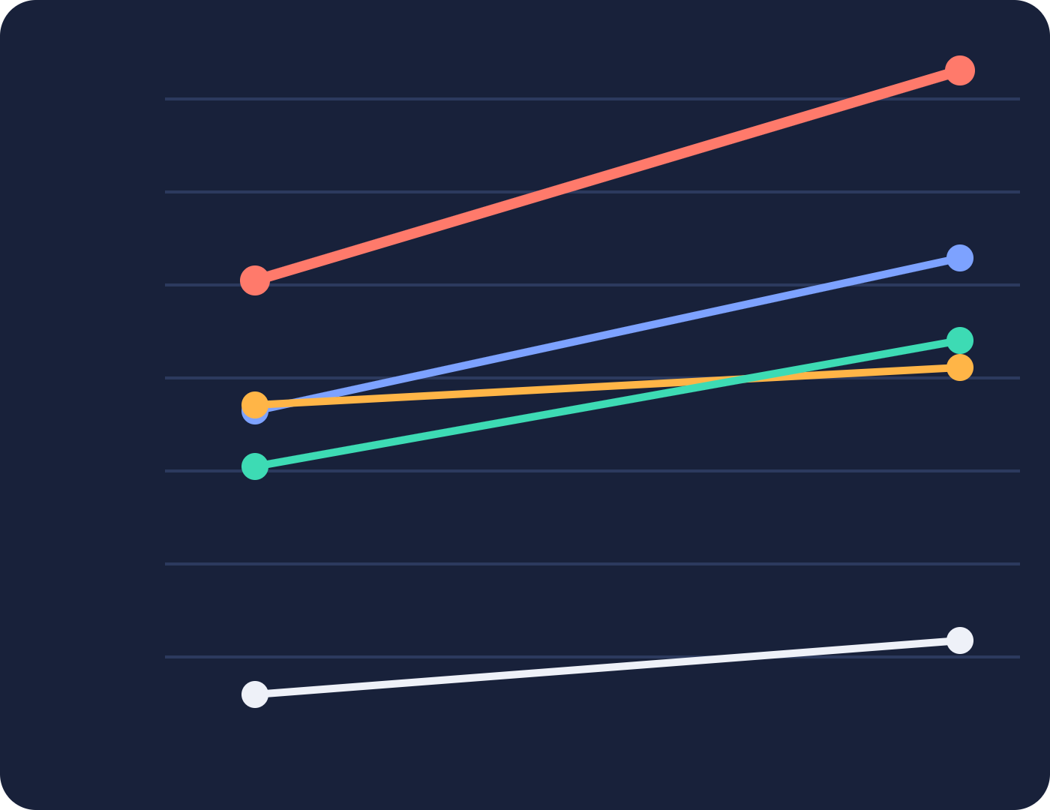
MEASURED · TIME PER OPERATION
What it actually costs.
100 s
trapdoor · 1.13 s → 204.8 s
181×
1 s
PEKS · 43.5 ms → 1.95 s
decrypt · 11.0 → 258.1 ms
trapdoor cost, n = 4 → 16
encrypt · 51.3 → 132.2 ms
10 ms
At n = 16 the trapdoor is 99% of per-use time. Verify stays under 1 ms.
0.1 ms
verify · 0.04 → 0.15 ms
n = 4
n = 16
Log scale. Absolute times are our Python reference implementation; the growth rate is the scheme's, and n = 16 is still far from secure.

Slide 38
ENCRYPT / DECRYPT · SUPPLIED BY US
Decryption: the equation solving itself.
Encrypt
Decrypt
c₀ = Aᵀs + e
1 find short x with A·x = u (needs the trapdoor)
mask carrier: s random, e small noise
2 xᵀc₀ = xᵀ(Aᵀs + e) = (A·x)ᵀs + xᵀe = uᵀs + xᵀe
c₁ = uᵀs + e′ + b·⌊q/2⌋
xᵀAᵀ becomes uᵀ because A·x = u: the exact mask, rebuilt
bit b rides on ⌊q/2⌋, hidden by uᵀs
3 c₁ − xᵀc₀ = (
uᵀs
+ e′ + b⌊q/2⌋) − (
uᵀs
+ xᵀe)
= b·⌊q/2⌋ + (e′ − xᵀe)
the mask uᵀs cancels
4 round(b·⌊q/2⌋ + noise) → b if |e′ − xᵀe| < q/4
Anyone can encrypt: only the public A, u are needed.
round to 0 or ⌊q/2⌋: that is the message bit b
Same q/4 bound as search, but stricter: every bit of the record must satisfy it at once.
The paper gives no encryption scheme. This is the standard dual-Regev instantiation, consistent with its own GPV/ABB primitives.

Slide 39
FINDING 10 · THE SECURITY MODEL
1 of 7 threats fits the security model.
Ciphertext indistinguishability
YES
the one property it proves
Key recovery from the public key
NO
LWE-hard premise fails at these parameters
Offline keyword guessing
NO
no keyword-guessing notion
Universal-ciphertext forgery
NO
no submission oracle; passive IND-CKA only
Trapdoor replay
NO
no requester authentication
Access-pattern leakage
NO
no leakage or observability modelled
Forward security, as a proven property
PARTIAL
break-in phase exists; never isolated and proven
The proof covers one property, and guarantees nothing for it where it counts.

Slide 40
THE THESIS
The paper's two defining ideas are the source of its flaws.
Under-specification
Public decentralization
H₁, H₂ · parameters
noise calibration
well-formedness · authentication
leakage
replay
universal-ciphertext poisoning
each gap is load-bearing
the ledger enables all three
Secure or efficient. Never both, at any parameters it was tested on.

Slide 41
Every attack has a fix.
None of them is free.
PART 3 · SOLUTIONS
Two kinds of repair: change the cryptography, or change who may do what.
Fixing the flaws means rethinking the two ideas behind them: small parameters and a fully public ledger.
Notes:
Part 3: what it takes to repair PPSEB. Every attack from Part 2 has a known fix. The fixes fall into two kinds: changing the cryptography itself, which covers the key break, forward security and norm drift; and changing who is allowed to do what, which covers keyword guessing, forgery, replay and leakage. The catch, which the last slide makes concrete, is that almost every fix costs either speed or openness.

Slide 42
Bigger lattices, same cost: move to Module-LWE.
SOLUTION · THE CRYPTOGRAPHY
TODAY · PLAIN LWE
FIXED · MODULE-LWE
n × m matrix
one polynomial
Public key
O(n²)
O(n log n) with NTT
Multiplication
broken by LLL, β = 2
secure dimension
At a usable cost
THEN · FORWARD SECURITY
ALREADY HELD · NORM DRIFT
Tree-based key evolution
Re-sample each period
Old keys deleted, derivation one-way by construction.
Our corrected KeyExt: norm stays 5–9 over 9 periods.
Small parameters can't be made safe. LLL finds short vectors in small lattices.
Notes:
The root cause of the key break and the cost blow-up is the same: plain LWE needs large parameters, and at large parameters it is slow and its keys are huge. Module-LWE, the structure behind Kyber and Dilithium, fixes both: the public key becomes a polynomial instead of a matrix, and NTT makes multiplication n log n. So we get a secure dimension at a usable cost. The price is a full re-derivation of the scheme; porting the FRD keyword encoding and basis delegation to rings is the hard part. Keeping small parameters is not an option: LLL finds short vectors in small lattices. Once parameters are secure, forward security becomes meaningful, and the linear NewBasisDel chain should become Canetti-Halevi-Katz style tree delegation. Norm drift needs no real fix: our corrected KeyExt already keeps it between 5 and 9 over 9 periods; re-sampling to a fixed quality guarantees it long-term.

Slide 43
Four attacks, four doors closed.
SOLUTION · THE PROTOCOL
FINDING 3
→
PAEKS
Sender authenticates the keyword. Guesses can't be built.
Offline keyword guessing
FINDING 5
→
ZK well-formedness
The chain rejects CT₂ = 0 and any fake LWE sample.
Universal ciphertext
FINDING 7
→
Signed + nonce
Trapdoor replay
Each trapdoor works once, for one doctor.
FINDING 6
→
ORAM / PIR
The ledger no longer shows which record matched.
Access-pattern leakage
A signature proves who sent it, not that it is real. Forgery needs a proof.
Notes:
Four attacks used the protocol, not the maths. Keyword guessing works because anyone can build a keyword ciphertext and run the public Verify. PAEKS, Huang and Li 2017, which is the paper's own reference 4, has the sender authenticate the keyword ciphertext with their secret key, so an attacker can't build test ciphertexts. The universal ciphertext gets through because nothing checks well-formedness. A signature won't help, since anyone can register as a patient; a zero-knowledge proof that CT2 is a genuine small-noise LWE sample, checked by the contract, does. Rejecting CT2 = 0 is a cheap stopgap. Replay is the easiest: sign each trapdoor with a nonce and expiry, and authorize the requester before the cloud returns the record. Leakage is the hardest: ORAM or PIR hide which record is matched and fetched; padding and dummy queries are a cheaper partial fix against frequency analysis.

Slide 44
Each fix costs speed, openness, or nothing.
SOLUTION · THE TRADE-OFF
Costs speed
Costs openness
Nearly free
heavier maths per operation
a secret enters the public chain
standard practice, just missing
Module-LWE rebuild
PAEKS keyword signing
Signed one-time trapdoors
ZK well-formedness proofs
ORAM / PIR on the ledger
Norm re-sampling
Tree-based key evolution
A secure PPSEB is buildable. A secure, fast and fully public one is not.
Notes:
Sorting the fixes by what they cost tells the real story. The Module-LWE rebuild, zero-knowledge proofs and tree-based key evolution all cost speed. PAEKS and oblivious access cost openness: verification needs a secret, or the ledger can no longer be fully public. ORAM and PIR are expensive too. Only replay protection and norm re-sampling are nearly free. So a secure PPSEB can be built, but only by giving up part of what the paper sells: efficiency and fully public, decentralized verification.

Slide 45
Every fix, measured.
Every limit, stated.
PART 4 · WHAT WE BUILT
MedVault-PQ: the same attacks, run again on the hardened system. 20 trials per cell.
Five fixes are built and tested; four stay on paper, each with its cost written down.

Slide 46
Four attacks, run again.
MEASURED · THE PROTOCOL FIXES
FINDING 3
→
PAEKS-style (mode C)
Keyless guessing 17/20 → 0/20, with Verify and the trapdoor still public.
Offline keyword guessing
FINDING 5
→
Shape check (A′)
Plant refused; 0 of 1 000 honest ciphertexts refused. Necessary, not sufficient.
Universal ciphertext
FINDING 7
→
Signed + nonce
Replay: search and fetch
Both replays rejected: reused_nonce. A replay never yields plaintext.
FINDING 6
→
Commitments + PIR
Chain labelling 72% → 19%, chance is 18%.
Access-pattern leakage
The search node still sees the pattern: 76%. Stated, not hidden.

Slide 47
FINDING 6 · AFTER THE FIX
The chain goes quiet. The search node does not.
TIER 1 · GROUPS VISIBLE ON THE CHAIN
TIER 2 · LABELLING ACCURACY, 10 SEEDS
7 → 0
76%
18%
19%
random chance
PPSEB's chain → mode B's chain
the search node still recovers every group, 100% pure
mode B search node
mode B chain
Cover queries lower the search node to 36% at 2× traffic, never Tier 1: co-access and group sizes do not change.

Slide 48
FINDING 10 · AFTER THE FIX
Every threat now has a game and a test.
Offline keyword guessing
CLOSED
modes B and C: keyless 0/20; the insider succeeds by design
Replay of search and fetch
CLOSED
mode B: signed, nonce-bound, reused_nonce
Universal-ciphertext forgery
PARTIAL
outsiders refused; a registered patient needs a ZK proof
Access-pattern leakage
PARTIAL
chain at chance; the search node still at 76%
Key recovery from the public key
OPEN
parameters: a Module-LWE rebuild, design-only
Forward security
OPEN
vacuous at these parameters; key tree is structure only
Ciphertext indistinguishability
WEAK
the paper's own game: at most 7.4 bits here
Games G0–G8, each tied to a test that fails if it breaks. Closed means measured, not proven.

Slide 49
Each fix costs speed, openness, or nothing.
MEASURED · THE TRADE-OFF
Costs speed
Costs openness
Nearly free
measured, toy parameters
search moves off the chain
standard practice, measured
Mode C: ≈ 630 ms / search
Mode B: Verify not public
Signed one-time requests
PEKS entry 5.9 KB vs 96 B
Search node still sees all
Shape check, 0 false rejects
Cover traffic: 2× searches
Mode C keeps the chain public; mode B is ≈ 2 000× faster. No mode is both.

